Slide 1

Intelligence vs Artificial Intelligence
Suspended Animation
Avery and Sophie Jensen

Slide 2
Overview - pages
Title page
Slide 2 - Overview
Slide 3 - Introduction
Slide 4-5 - History or background
Slides 6-7 - Plan and Implementation
Slide 8 - Upsides to this advancement
Slide 9 - Downsides to this advancement
Slide 10 - Summary
Slide 11 - References

Slide 3
Introduction

Slide 4
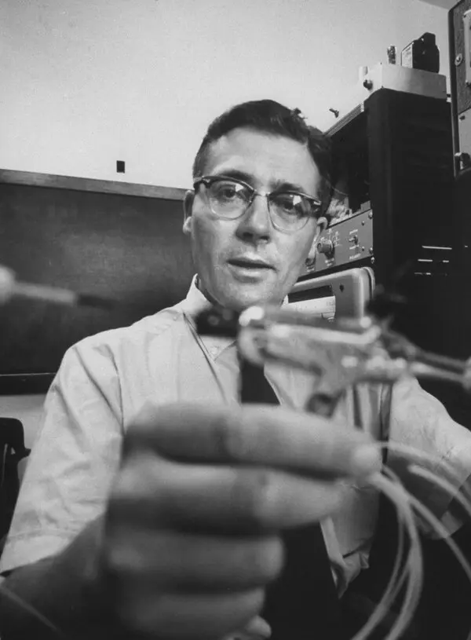
History/Background
1950s - NASA funded research
James Lovelock - tried theory on hamsters
British Medical Journal
Russian Peasants - able to “hibernate”
Notes:
https://psmag.com/social-justice/big-sleep-potential-benefits-hibernation-humans-83327
One recipient of that funding was a young James Lovelock. The scientist would dunk hamsters into ice baths until their bodies froze. Once he could no longer detect a heartbeat, he would re-animate them by placing a hot teaspoon against their chest (in later experiments, Lovelock warmed to the space-age theme by building a microwave gun out of spare radio parts to more gently revive his test subjects). These experiments on the flexibility of life would set him on the path to his most famous work, the "Gaia hypothesis" of the world as a living super-organism.
IN 1900, THE BRITISH Medical Journal published an account of Russian peasants who, the author claimed, were able to hibernate. Existing in a state approaching “chronic famine,” residents of the northeastern Pskov region would retreat indoors at the first sign of snow, and there gather around the stove and fall into a deep slumber they called "lotska." Waking once a day to wash some hard bread down with water, the family took it in turns to watch the fire, only rousing themselves fully once spring had broken. No trace of the sleepy peasants of Pskov has ever emerged since, but the fantasy of human hibernation persists, and very occasionally, something that looks very similar to it crosses into reality.

Slide 5
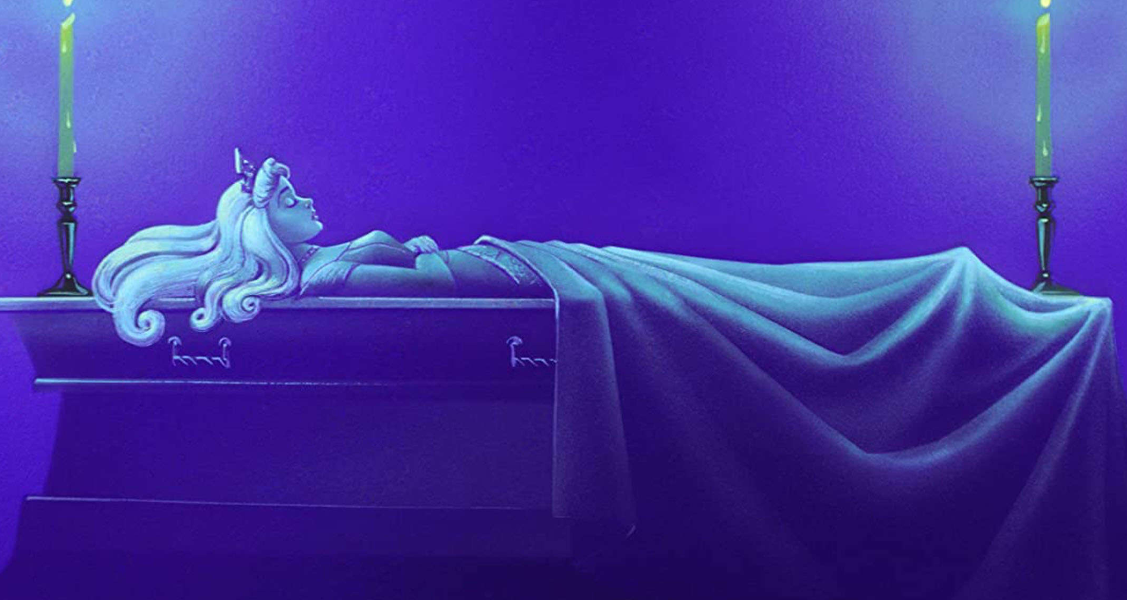
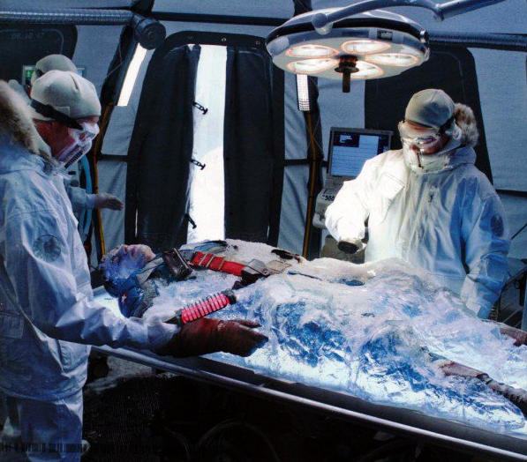
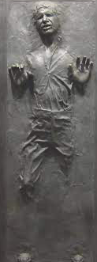
History/Background
Used in Fiction
Romeo and Juliet
Sleeping Beauty
Star Wars
Captain America
Avatar
Evidence of Past Suspended Animation
Mitsutaka Uchikoshi
Anna Bågenholm
Notes:
https://www.theguardian.com/world/2006/dec/21/japan.topstories3
When a passing climber found him 24 days later, Mr Uchikoshi's body temperature had fallen to just 22C (72F), he had a barely discernable pulse and he was suffering from multiple organ failure and blood loss.
Doctors who treated Mr Uchikoshi believe he lost consciousness after his fall and that his body's natural survival instincts kicked in, sending him into a state akin to hibernation as the temperature on the mountain dropped as low as 10C.
"He fell into a state similar to hibernation and many of his organs slowed, but his brain was protected," Dr Shinichi Sato, head of the hospital's emergency unit, told reporters. "I believe his brain capacity has recovered 100%."
Doctors said they did not expect him to experience any lasting ill-effects.
Mr Uchikoshi said he could not remember anything after the second day of his ordeal on the mountain, a popular spot for hikers and picnickers. One report that emerged while he was still in hospital said he had sipped bottled water and barbecue sauce before falling unconscious.
Experts say it remains unclear how Mr Uchikoshi managed his extraordinary feat of survival with his metabolism almost at a standstill
https://psmag.com/social-justice/big-sleep-potential-benefits-hibernation-humans-83327
Anna Bågenholm was on a skiing holiday in Norway when she crashed head first into a frozen stream and became trapped under the ice. When rescuers finally arrived, the Swedish radiologist had been submerged for 80 minutes, and her heart and breathing had stopped. Doctors at Tromsø University Hospital recorded a body temperature of 13.7°C, the lowest ever observed in a victim of accidental hypothermia. By all accounts she appeared to have drowned. And yet, after careful re-warming and 10 days spent in intensive care, Bågenholm woke up. She went on to recover almost fully from her cold brush with death. Under normal circumstances, even a few minutes trapped underwater would be enough to drown a person, and yet Bågenholm had survived for over an hour. Somehow the cold had preserved her.

Slide 6
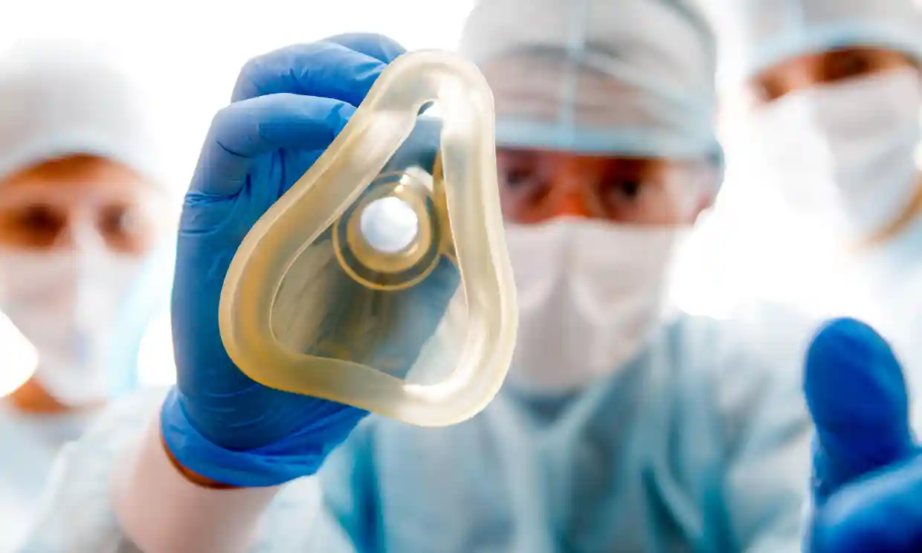
Plan and Implementation
Could affect all life
Ex: waiting for medical care
Delay onset of cell death
Buy more time for surgery
Internal bleeding/ heart attack victims
Notes:
https://amp.theguardian.com/science/2019/nov/20/humans-put-into-suspended-animation-for-first-time
Doctors have put humans into a state of suspended animation for the first time in a groundbreaking trial that aims to buy more time for surgeons to save seriously injured patients.
The process involves rapidly cooling the brain to less than 10C by replacing the patient’s blood with ice-cold saline solution. Typically the solution is pumped directly into the aorta, the main artery that carries blood away from the heart to the rest of the body.

Slide 7
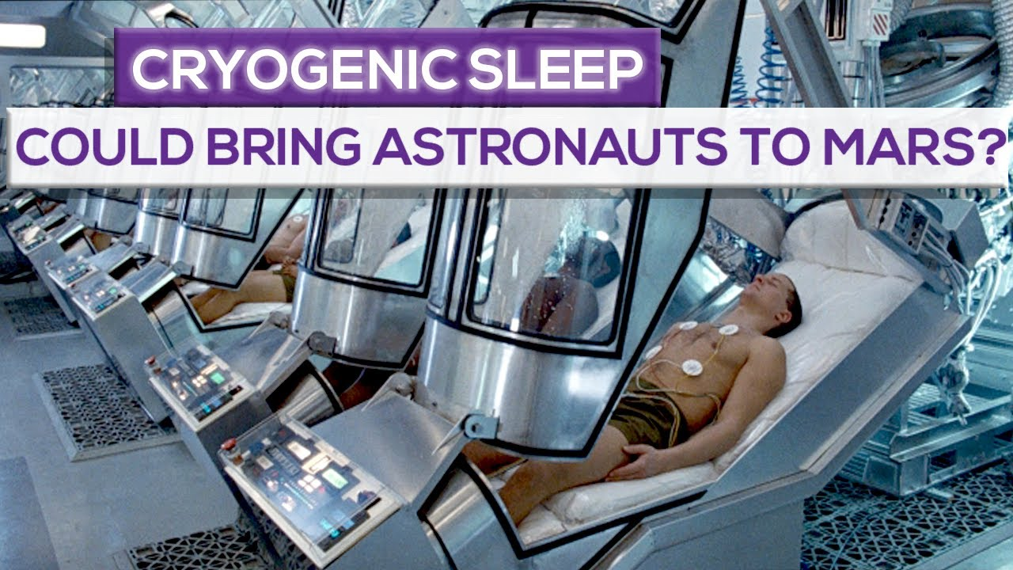
Plan and Implementation
Future Prospects: Far space travel
Astronauts put into state of sleep
Allows for travel across space
Energy and cost savings
Notes:
https://amp.theguardian.com/science/2019/nov/20/humans-put-into-suspended-animation-for-first-time
Suspended animation could be an alternative to traditional travel. Controlled reduction of humans’ overall body temperature could effectively send space travelers into a state of hibernation, allowing for significantly reduced consumption of resources while simultaneously avoiding some of the negative effects of long-term cohabitation in cramped crew quarters.

Slide 8
Pros/Upsides to this advancement
Medical
Gives doctors more time to operate
Space
Travel without needing food/water
Notes:
https://psmag.com/social-justice/big-sleep-potential-benefits-hibernation-humans-83327
SUSPENDED ANIMATION, THE ABILITY to set a person’s biological processes on hold, has long been a staple of science fiction. Interest in the field blossomed in the 1950s as a direct consequence of the space race. NASA poured money into biological research to see if humans might be placed in a state of artificial preservation. In this state, it was hoped, astronauts could be protected from the dangerous cosmic rays zapping through space. Sleeping your way to the stars also meant carrying far less food, water, and oxygen, making the ultimate long-haul flight more practical.

Slide 9
Cons/Downsides to this advancement
Doesn’t save enough energy
Ethical implications of freezing humans
Issues with bringing humans out
Full hibernation is still unheard of
Notes:
https://vce.usc.edu/volume-1-issue-1/the-frozen-undead-ethical-implications-of-suspended-animation-and-cryonics/
The most important ethical concern in cryonics is legitimacy, or the lack thereof. People are trusting scientists and engineers to revive their frozen bodies in the future. This is an enormous amount of faith in our advancement of biomedical technologies. What if this assurance of resuscitation is false hope? We have basic human rights that apply to everyone. The right to live is one of the most fundamental human rights. Although patients have the right to choose cryonics, this “false hope” could indirectly alter their choice. For example, an individual decides to choose the option of cryonics in his life insurance policy. Later in his life, he suffers from a coma and does not wake up for months. He is sent to a cryogenic freezing facility and will be kept there for however long that facility exists. However, many patients come back after being in a comatose state for years. The option of cryogenics cannot even begin to promise resuscitation in the future. This patient could have potentially awakened.
https://www.dailymail.co.uk/sciencetech/article-10755573/Suspended-animation-space-travel-never-possible.html
Chilean researchers set out to investigate whether people could hibernate like bears, which would effectively allow us to snooze during trips through space that last longer than a lifetime.
In naturally hibernating mammals – such as bats, several marsupials and rodents – energy expenditure can be reduced by 98 per cent of normal levels.
However, the Universidad Austral de Chile researchers found that hibernation seems to only be beneficial at small sizes.

Slide 10
Summary
Medical care would be significantly better
Travel to new planets
Would it save enough energy?
Are there unforeseen consequences?

Slide 11
References
Injured hiker survived 24 days on mountain by 'hibernating' | World news | The Guardian
Humans put into suspended animation for first time | Medical research | The Guardian
Suspended animation for emergency medicine: your questions answered | New Scientist
The Big Sleep: Suspended Animation and the Potential Benefits of Human Hibernation - Pacific Standard
The Frozen-Undead: Ethical Implications of Suspended Animation and Cryonics - Viterbi Conversations in Ethics

